Slide 1

CYBERSECURITY TECHNICAL DEEP DIVE
PE File
Analysis
Deep Dive into Portable Executable Structure for Malware Analysis and Reverse Engineering
Malware Analysis
Reverse Engineering
Anomaly Detection
Static & Dynamic
Windows Internals
Packer Identification

Slide 2
Contents
01
PE File Architecture
DOS Header, PE Header, Optional Header, and the overall file structure that defines Windows executables
02
Section Analysis
.text, .data, .rsrc sections and their characteristics, permissions, and security implications
03
Import/Export Tables
Dynamic linking, Import Address Table (IAT), DLL resolution, and export mechanisms
04
Anomaly Detection
Packed malware identification, entropy analysis, suspicious characteristics, and analysis tools

Slide 3

CHAPTER 01
PE File
Architecture
Understanding the fundamental structure of Portable Executable files
DOS Headers
PE Headers
Optional Headers

Slide 4
PE File Structure Overview
Windows Executable Format
Sequential layout from DOS header to section data
DOS Header
Offset: 0x0000
PE File Layout
64-byte MS-DOS compatibility header
e_magic: MZ (0x5A4D)
e_lfanew
DOS Header (64 bytes)
MZ signature | e_lfanew
DOS Stub
Variable size
DOS Stub
MS-DOS error message program
"This program cannot be run in DOS mode"
PE Signature (4 bytes)
PE Header
@ e_lfanew
PE\0\0 (0x00004550)
Signature + File Header + Optional Header
File Header (20 bytes)
PE\0\0 (0x4550)
Machine | Sections | Timestamp
Optional Header
Section Table
40 bytes × n
EntryPoint | ImageBase | Data Directory
Array of IMAGE_SECTION_HEADER structures
Section Headers
Name | VirtualAddress | Characteristics
Section Data
Variable
.text
.data
.rsrc
Actual code, data, and resources
Code
Data
Resources
Key Concepts
File Offset: Physical location on disk
Section Alignment
4KB (0x1000)
RVA: Relative Virtual Address in memory
File Alignment
512B (0x200)
VA: Virtual Address = ImageBase + RVA

Slide 5
DOS Header: The Entry Point
64-byte MS-DOS compatibility header with critical pointer to PE structure
DOS Header Structure
Hex Dump Example
e_magic
WORD | Offset: 0x00
Offset: 0x00000000
Magic number: 0x5A4D ("MZ")
0000:4D 5A 90 00 03 00 00 00 04 00 00 00 FF FF 00 00
MS-DOS executable signature
0010: B8 00 00 00 00 00 00 00 40 00 00 00 00 00 00 00
0020: 00 00 00 00 00 00 00 00 00 00 00 00 00 00 00 00
e_cblp, e_cp, ...
WORD | Various
0030: 00 00 00 00 00 00 00 00 F0 00 00 00 0E 1F BA
MS-DOS specific fields (mostly unused in PE)
Bytes 4D 5A = "MZ" signature (little-endian)
e_lfanew
LONG | Offset: 0x3C
Bytes F0 00 00 00 = e_lfanew (0xF0 = 240)
File offset to PE header: 0x000000F0
Most critical field - tells Windows where PE starts
DOS Stub Message
Historical Context
This program cannot be run in DOS mode
"MZ" stands for Mark Zbikowski, an early MS-DOS developer. This header ensures that if a PE file is run on MS-DOS, it displays an error message gracefully.
Displayed when PE runs on MS-DOS systems
Critical for Analysis
Always check e_lfanew first - if it's corrupted or points to invalid location, the PE file is malformed.

Slide 6
PE Header & Optional Header
Core metadata structures defining file characteristics and loading parameters
PE Signature
File Header
Optional Header
DWORD Signature
Machine
Magic
PE\0\0
0x014C (x86) | 0x8664 (x64)
0x10B (PE32) | 0x20B (PE32+)
Hex: 0x00004550
NumberOfSections
AddressOfEntryPoint
Count of sections in file
RVA of first instruction
4-byte signature identifying this as a PE file. Always follows DOS stub at offset specified by e_lfanew.
TimeDateStamp
ImageBase
Unix timestamp of linking
Preferred load address
Characteristics
Subsystem
Flags (EXE, DLL, etc.)
GUI (2) | Console (3)
Data Directory (16 Entries)
[0] Export
[1] Import
[2] Resource
[5] Base Reloc
Function exports
DLL imports
Icons, dialogs
Relocation table
[6] Debug
[12] IAT
[14] COM+
... (8 more)
Debug info
Import addresses
.NET metadata
TLS, Config, etc.
PE32 vs PE32+
ASLR Impact
PE32: 32-bit, 224-byte Optional Header. PE32+: 64-bit, 240-byte with extended fields.
If ImageBase isn't honored due to ASLR, the loader uses the relocation table to fix addresses.

Slide 7

CHAPTER 02
Section
Analysis
Exploring code and data sections within PE files
.text Section
.data Section
.rsrc Section

Slide 8
Common PE Sections
Organized containers for code, data, and resources with specific memory permissions
.text Section
EXECUTE
READ
Contains executable machine code - the program's instructions. Typically the largest section. Marked as executable and read-only for security.
EntryPoint RVA
CPU Instructions
.data Section
READ
WRITE
.rdata Section
READ
Initialized global and static variables with initial values.
Read-only data: constants, string literals, import/export tables.
Global variables | Static variables
Constants | String literals
.rsrc
READ
.reloc
READ
.idata/.edata
READ
Resources: icons, images, dialogs, menus.
Relocation table for address fixing.
Import/export function data.
Icons, Bitmaps, Dialogs
Base relocations
IAT, EAT
Section Header Structure (40 bytes)
Name
VirtualAddress
SizeOfRawData
Characteristics
8-byte ASCII (e.g., ".text\0\0\0")
RVA in memory when loaded
Size on disk (file alignment)
Flags (EXECUTE, READ, WRITE)

Slide 9
Section Characteristics & Permissions
Memory protection flags and their security implications for malware analysis
Key Characteristic Flags
Malware Indicators
IMAGE_SCN_MEM_EXECUTE
0x20000000
EXECUTE + WRITE
Section can be executed as code. Essential for .text sections.
High Risk: Writable and executable memory enables code injection and self-modifying code.
IMAGE_SCN_MEM_READ
0x40000000
Unusual Permissions
Section can be read. Required for data access.
Suspicious: Data sections with EXECUTE flag or code sections with WRITE flag.
IMAGE_SCN_MEM_WRITE
0x80000000
Packed Sections
Section can be written to. Needed for mutable data.
Obfuscation: Packers often set RWX permissions for unpacking stubs.
Common Combinations
.text: EXECUTE | READ
.data: READ | WRITE
.rdata: READ
Memory Protection Constants Mapping
PAGE_EXECUTE
PAGE_EXECUTE_READ
PAGE_READWRITE
PAGE_EXECUTE_READWRITE
Execute only
Execute + Read
Read + Write
R/W/X (Dangerous)
0x20000000
0x60000000
0xC0000000
0xE0000000

Slide 10
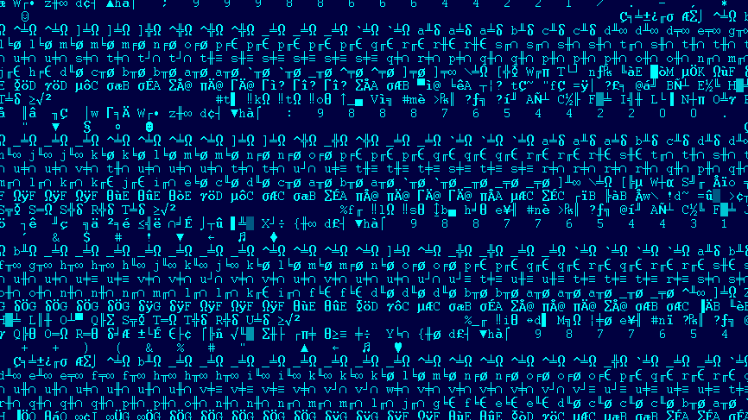
CHAPTER 03
Import/Export
Tables
Dynamic linking and function resolution mechanisms
IAT Resolution
DLL Loading
Export Table

Slide 11
Import Address Table (IAT) & DLL Resolution
Runtime linking mechanism enabling modular code execution
Import Directory Structure
Dynamic Linking Process
IMAGE_IMPORT_DESCRIPTOR
1
Loader Reads Import Directory
One per imported DLL. Contains pointers to DLL name, Import Lookup Table (ILT), and Import Address Table (IAT).
Windows loader parses DataDirectory[1] to find import descriptors.
2
DLLs Loaded into Memory
Each DLL in Import Directory is loaded via LoadLibrary().
Import Lookup Table (ILT)
3
Function Addresses Resolved
Array of function names/ordinals identifying imported functions. Used by the loader for resolution.
Loader uses GetProcAddress() to find the actual address of each imported function.
Import Address Table (IAT)
4
IAT Patched with Addresses
Resolved addresses are written into the IAT. Subsequent calls jump directly to the target function.
Runtime-resolved function addresses. Initially identical to ILT, then patched by the loader.
Import Resolution Visualization
Common DLL Imports
Call ExitProcess
↓ jmp [IAT_exit]
kernel32.dll
ntdll.dll
→ 0x7FFEABCD (Resolved)
CreateFile, WriteFile, VirtualAlloc
Nt*, Zw* functions
user32.dll
ws2_32.dll
MessageBox, RegisterClass
socket, connect, send
DLL Hijacking
Import Obfuscation
Imphash
Attackers can place malicious DLLs in the search path to override legitimate ones.
Malware may resolve APIs dynamically to hide imports from static analysis.
A hash of import table order used to identify related malware samples.

Slide 12
Export Directory Table
Function exposure mechanism for DLLs enabling inter-module communication
Export Directory Structure
Export Resolution Process
IMAGE_EXPORT_DIRECTORY
1. GetProcAddress("MyFunc")
Main export structure pointed to by DataDirectory[0]. Contains counts and RVAs to export data.
Application requests function by name
Name: RVA to DLL name
Base: Ordinal base
2. Binary Search Name Table
NumberOfFunctions: Total exports
NumberOfNames: Named exports
Loader searches Name Pointer Table for "MyFunc"
Export Address Table (EAT)
3. Get Ordinal Index
Array of RVAs pointing to the actual function implementations. Accessed by ordinal number.
Corresponding ordinal from Ordinal Table
Name Pointer Table
4. Lookup EAT
Ordinal used as index into Export Address Table
Array of RVAs to function names, sorted alphabetically for binary search. Enables GetProcAddress() by name.
5. Return Function Address
RVA converted to VA and returned to caller
Ordinal Table
Maps named exports to EAT indices. Each 16-bit ordinal is an index into the EAT.
Common Export Examples
DllMain (Entry Point)
Called when DLL is loaded/unloaded
ExportedFunc1, Func2...
Custom functions exposed by the DLL
Export Forwarding
Ordinal-Only Exports
Exports can redirect to another DLL's function, used by Windows to maintain compatibility.
Functions can be exported only by ordinal (no name), which is often used to hide functionality.

Slide 13
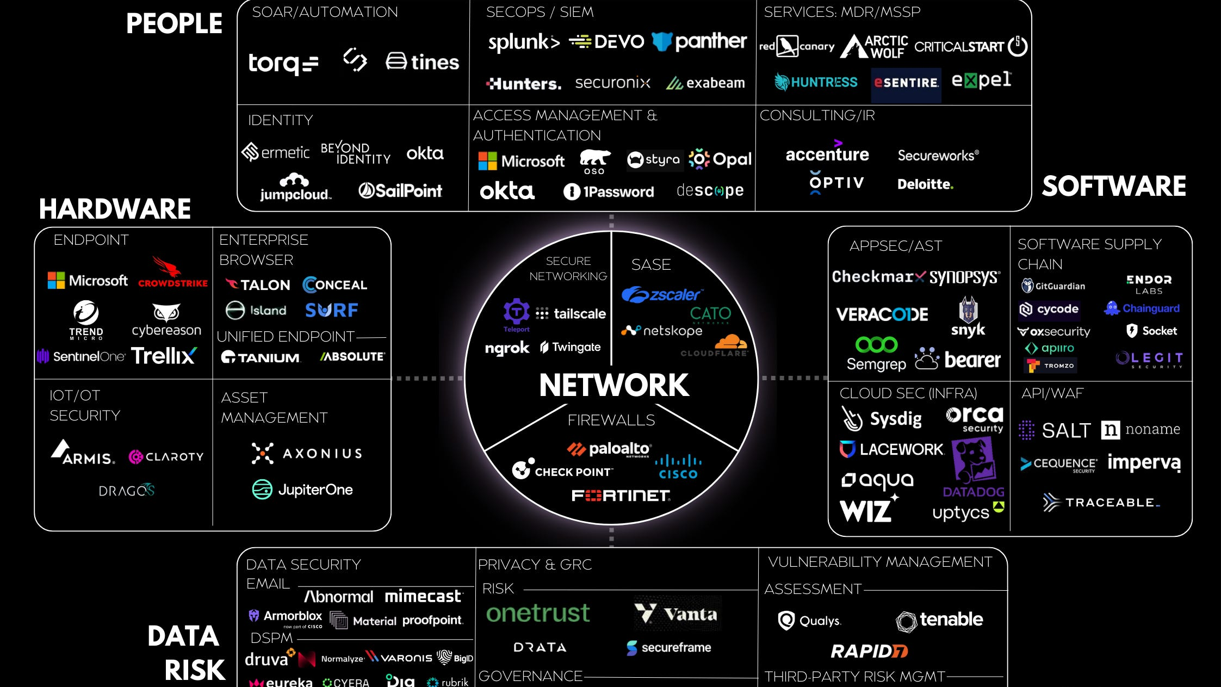
CHAPTER 04
Anomaly
Detection
Identifying suspicious characteristics and packed malware
Entropy Analysis
Packer Detection
Suspicious Flags

Slide 14
Packed & Suspicious Sections
Key indicators of obfuscation and malicious intent in PE files
Unusual Section Names
Suspicious Characteristics
UPX Packer
Common
Zero Raw Size
.upx0, .upx1, .upx2
Section has SizeOfRawData = 0 but VirtualSize > 0. Indicates runtime unpacking.
Popular open-source packer. Easy to identify and unpack.
Entry Point Outside .text
ASPack
Commercial
Entry point in .data, .rsrc, or custom section is a packer indicator.
.aspack, .adata
Commercial packer with advanced compression.
Size Mismatch
VirtualSize >> SizeOfRawData suggests packed content that expands at runtime.
Themida
Protector
.themida, .vmp0
Advanced protector with anti-debugging and VM protection.
Other Red Flags Indicators
Detection Tip
Tiny Import Table
Invalid Digital Signature
Use tools like DIE or PEiD to identify packer signatures. Unknown section names are a red flag.
Suspicious Timestamp
Overlapping Sections

Slide 15
Entropy Analysis & Detection Methods
Quantifying randomness to identify compression, encryption, and obfuscation
Understanding Entropy
Entropy Analysis Tools
Entropy measures data randomness on a scale from 0 (completely predictable) to 8 (completely random).
Detect It Easy (DIE)
Low Entropy (0-4)
Normal
Visual entropy graphs and packer signature detection.
Text, uncompressed data, structured formats
PEStudio
Medium Entropy (4-7)
Typical
Calculates section entropy and flags anomalies automatically.
Compiled code, some data sections
High Entropy (7-8)
Suspicious
PE-bear
Compressed or encrypted data
Comprehensive PE analysis with entropy visualization and section details.
Malware Statistics
Bintropy
Python library for entropy analysis and packed byte detection.
~50% of malware samples have entropy ≥7.2. High entropy is a strong packer indicator.
Additional Heuristics
Import Table: Only LoadLibrary/GetProcAddress
Section Names: Non-standard (.upx, .vmp0)
Entry Point: Outside .text section
Timestamp: Invalid or suspicious
Typical Section Entropy Ranges
.text
.data
.rsrc
Packed
4-6
3-5
4-7
7-8
Compiled code
Variables
Resources
Suspicious

Slide 16
Analysis Tools & Best Practices
Professional toolkit and systematic workflow for PE analysis
PE Viewers
Packer Detectors
Debuggers
PE-bear
Detect It Easy (DIE)
x64dbg
Comprehensive PE viewer with hex editor and structure parsing
Packer identification with entropy graphs and signature database
Open-source 32/64-bit Windows debugger with script support
CFF Explorer
Exeinfo PE
IDA Pro
Advanced header editing and resource modification
Extensive packer signature database and compiler detection
Industry-standard disassembler with interactive analysis
PEStudio
PEiD
Ghidra
Static analysis with blacklisting and entropy calculation
Classic packer detector with plugin support (discontinued)
NSA's free reverse engineering suite with decompiler
Analysis Workflow
1
Hash Verification
4
Entropy & Packer Detection
Calculate MD5, SHA1, SHA256. Check against VirusTotal.
Calculate section entropy. Use DIE/PEiD for packer identification.
2
String Analysis
5
Capability Analysis (Capa)
Extract ASCII/Unicode strings. Use FLOSS for obfuscated strings.
Identify behaviors: file operations, network, persistence.
3
PE Structure Review
6
Dynamic Analysis (if needed)
Examine headers, sections, imports, exports. Note anomalies.
Debug in sandbox (x64dbg). Monitor with ProcMon/Wireshark.
Safety First
Online Services
Always analyze malware in isolated VMs. Never on production systems.
VirusTotal, Hybrid Analysis, MalwareBazaar, unpac.me

Slide 17
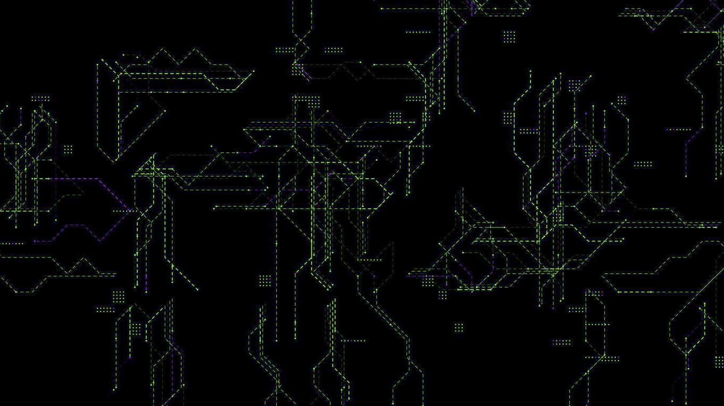
SUMMARY
Key
Takeaways
Structure Mastery
Anomaly Detection
Understanding headers, sections, and the import/export mechanism is fundamental to malware analysis.
High entropy, unusual section names, and suspicious permissions are key indicators of malicious intent.
Tool Proficiency
Systematic Approach
Mastery of tools like PE-bear, PEStudio, and DIE enables rapid identification of PE anomalies.
Following a structured workflow ensures thorough analysis and reduces the chance of missing critical details.
DOS/PE Headers
Section Analysis
Import/Export
Entropy Detection

